Slide 1
Css preprocessors

Slide 2
Problem
Building a function, reusing a definition or inheritance are hard to achieve. For bigger projects, or complex systems, maintenance is a very big problem.

Slide 3
Problem
New specs are being introduced to HTML as well as CSS. Browsers apply these specs while they are in proposal state with their special vendor prefixes. In some cases (as in background gradient), coding with vendor specific properties become a burden. You have to add all different vendor versions for a single result.

Slide 4
Solution
Pre-processors, with their advanced features, helped to achieve writing reusable, maintainable and extensible codes in CSS. By using a pre-processor, you can easily increase your productivity, and decrease the amount of code you are writing in a project.

Slide 5



Popular css preprocessors
Sass
Stylus
Less

Slide 6
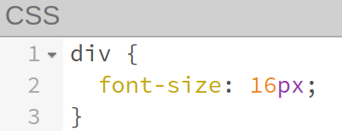
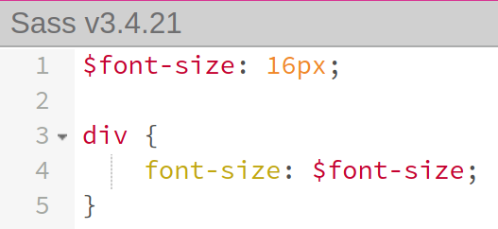
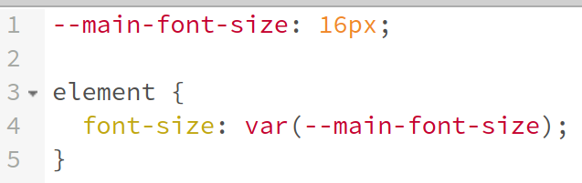
Features: Variables

Slide 7
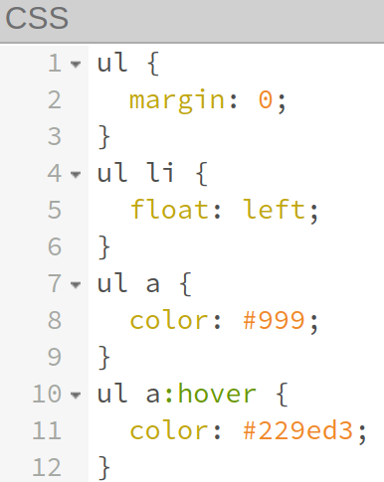
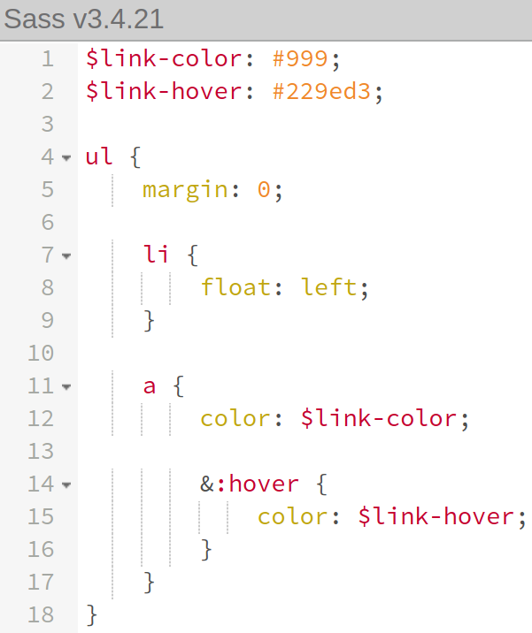
Features: Nesting

Slide 8
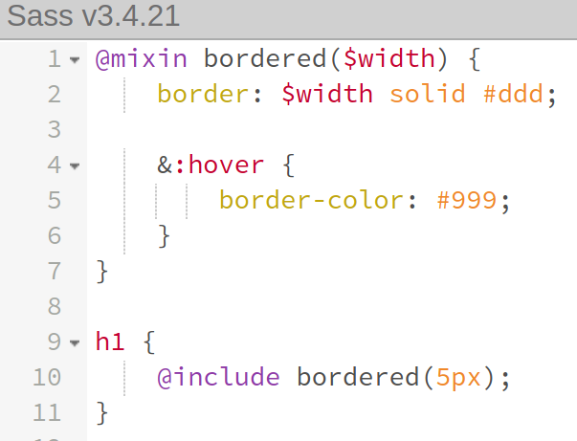
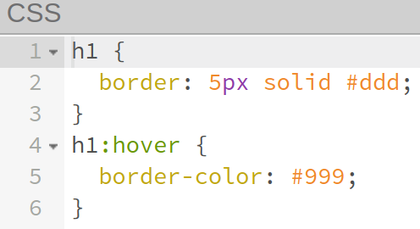
Features: Mixins

Slide 9
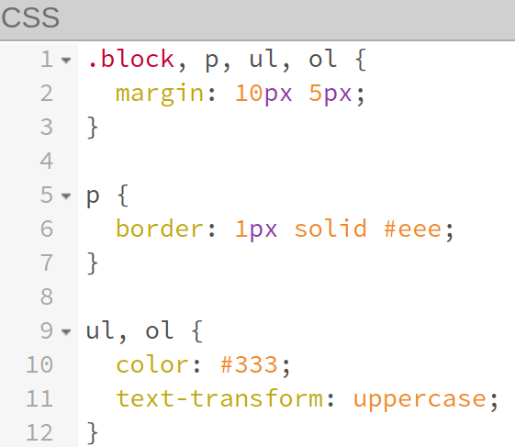
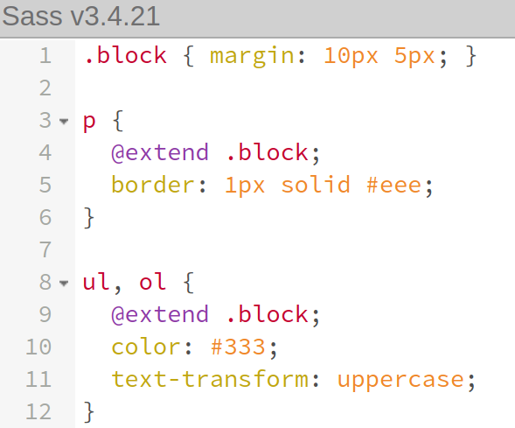
Features: Extends

Slide 10
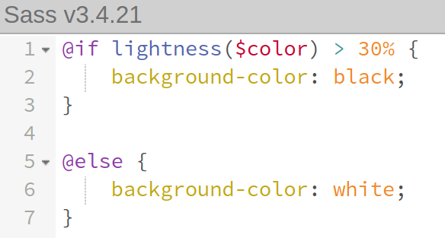
Features: If/else statements

Slide 11
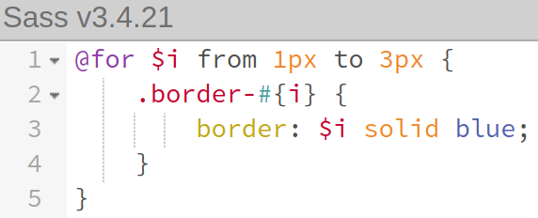
Features: Loops

Slide 12
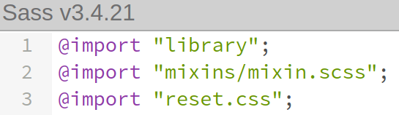
Features: Imports

Slide 13

PostCSS
PostCSS is a software development tool that uses JavaScript-based plugins to automate routine CSS operations.

Slide 14
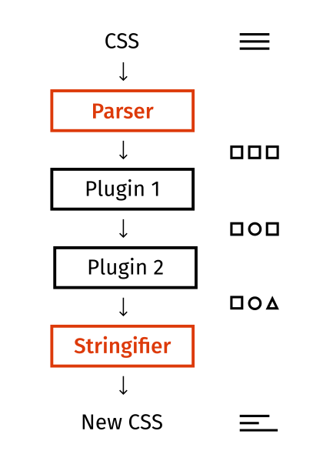
PostCSS workflow

Slide 15
Q&A

